Slide 1

Introduction
What (TH) is Machine Learning?
Dr. Abolfazl Saghafi
Assistant Professor of Statistics
Data Science Program Director
Notes:
Hello and welcome to this course in Machine Learning
I am Abolfazl Saghafi, Assistant Professor of Statistics in University of Sciences and I’m VERY excited to guide you trough this subject
I’m sure by now you must have heard about ML and AI every now and then, lets start by going over some basics and see what the hell is Machine Learning about

Slide 2

Summary
• Machine Learning, What and How
○ Supervised Learning
○ Unsupervised Learning
○ Reinforcement Learning
○ Deep Learning
• Expectations
○ Textbook
○ Table of Contents
Notes:
In this introductory video I explain what ML is and briefly describe different classes of ML algorithms

Slide 3
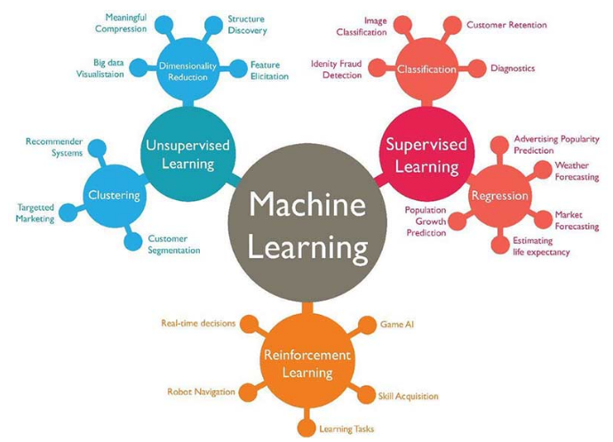
Machine Learning
[1]
Algorithms
Automatic Pattern Detection
Use the Patterns to Make Decisions
Notes:
The goal of ML is to write algorithms to automatically detect patterns in data, then use the uncovered patterns to make decisions under uncertainty. There are three major categories of ML algorithms. On one side we have Supervised Learning which further breaks down into more specific methods. Then we have Unsupervised Learning Algorithms and Reinforced Learning. There are also mixed learning algorithms that are a mix of these three

Slide 4
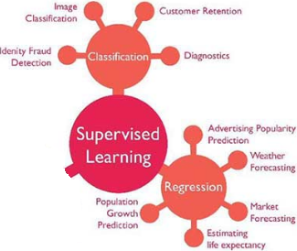

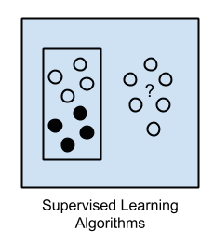


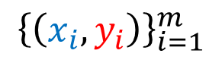
Supervised Learning
Learn a Pattern to map inputs to outputs
m example (inputs, outputs)
$$⇒$$
$${\left\{\left(x_{i},y_{i}\right)\right\}}_{i=1}^{m}$$
Predict outputs for any given inputs
$$⇒$$
Notes:
In SL, a teacher or coder, provides the computer with a set of examples, m pairs of (inputs, outputs), and the goal is to learn a pattern that maps inputs to outputs. Further, the pattern is used to predict outputs $y_{i}$ given new inputs $x_{i}$. This is actually how humans learn, we learn by examples.
Behind the scene, this is achieved through sophisticated programing and a good deal of Statistics and Optimization techniques. SL further breaks down into Regression and Classification

Slide 5
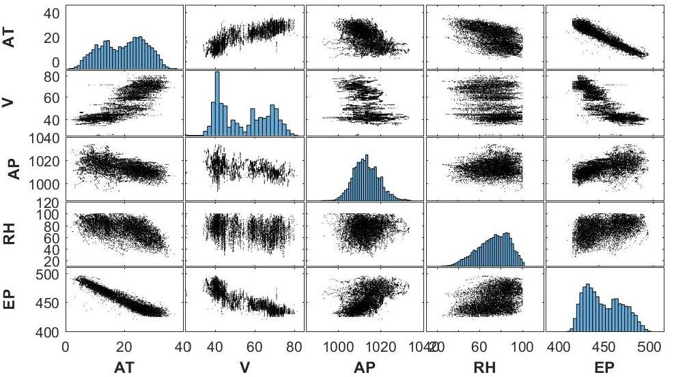
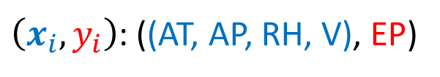
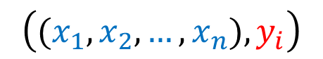
Regression
Input(s) - ONE output
$$\left({(x}_{1},x_{2},…,x_{n}),y_{i}\right)$$
$\left(x_{i},y_{i}\right)$: ((AT, AP, RH, V), EP)
Hourly average Ambient Temp. (T), Ambient Pressure (AP),
Relative Humidity (RH) and
Exhaust Vacuum (V) to predict the net hourly Electrical Energy Output (EP) of a power plant [2].
Notes:
In Regression problems we have one or many input variables, and ONE output variable which is REAL-VALUED. The goal is to predict the output using the inputs.
In this example, the goal is to predict Electrical Energy output of a power plant using some input variables such as Hourly Temp, etc. The relation between each input variable and output could be linear such as AT, or more complicated such as V.

Slide 6
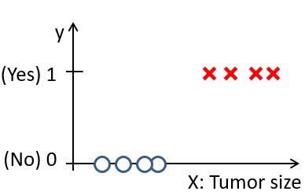
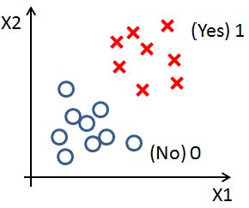
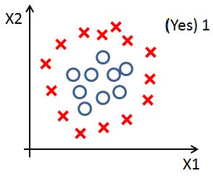
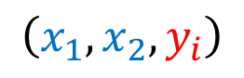
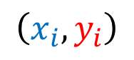
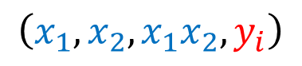
Classification
$$\left(x_{1},x_{2},y_{i}\right)$$
$$\left(x_{i},y_{i}\right)$$
The output is categorical with two or more categories [3].
0: Benign
1: malignant
$$\left(x_{1},x_{2},x_{1}x_{2},y_{i}\right)$$
Notes:
When the output variable is categorical, the problem is called, Classification. The goal is to find a decision boundary that separates different class categories.
In here we have tumor size as input and output is whether the tumor is benign or malignant. Then we have two inputs $x_{1},x_{2}$, and then we have three inputs $x_{1},x_{2},x_{1}x_{2}$. In all three examples, we are trying to find a boundary that separates the two category of benign and malignant tumors.

Slide 7
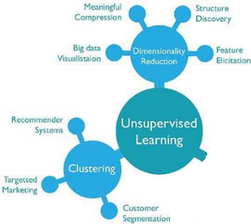
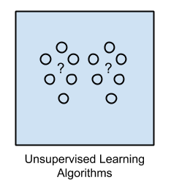
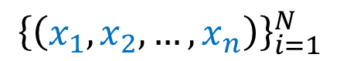
Unsupervised Learning
Learn a Pattern between inputs
Everything is (inputs)
$$⇒$$
$${\left\{\left(x_{1},x_{2},…,x_{n}\right)\right\}}_{i=1}^{N}$$
Label inputs based on the learned pattern
$$⇒$$
Notes:
In Unsupervised Learning Algorithms, outputs are unknown, we only have the inputs. The goal is to discover interesting structure in the data, then use this structure to make decisions

Slide 8
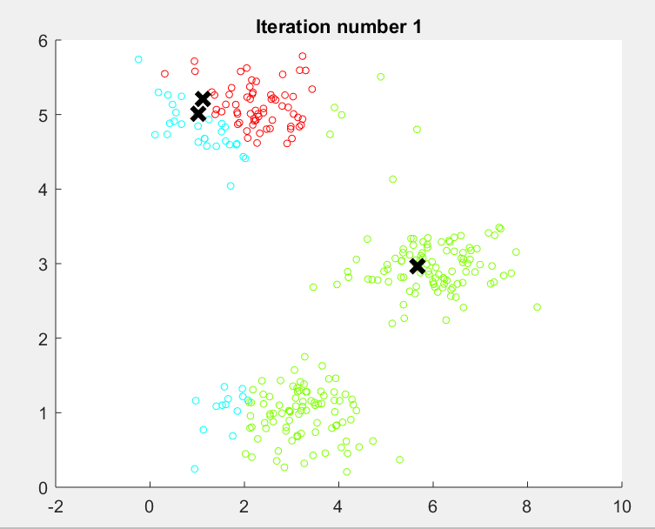
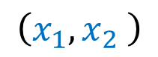
Clustering
$$\left(x_{1},x_{2} \right)$$
Clustering methods can be used jointly with Supervised Learning to create labels [2].
Notes:
Clustering is one of the important Unsupervised Learning algorithms where the goal is to group the data based on some similarity of closeness measure.
This example shows how computer uses some given instructions to cluster inputs into three clusters. Figuring this out is easy to us but to develop techniques and codes for a computer to perform such tasks could be difficult. When we increase the problem space, that is the number of variables, computers find the clusters way faster than we can do

Slide 9
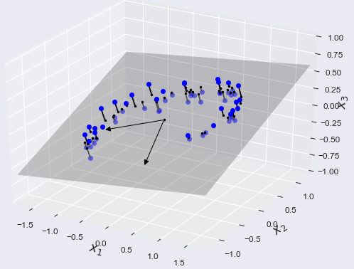
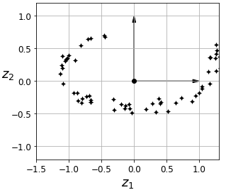
Dimension Reduction
Reducing the number of variables by mixing them together or projecting the whole data into a subspace is the goal of dimension reduction.
Mapping 3D data to a 2D space.
Notes:
Another important class of unsupervised learning algorithms is Dimension Reduction which aims to reduce the number of variables by mixing them together in a linear or non-linear fashion. This process always brings information loss but in many cases, the information loss worth the reduction in problem complexity.

Slide 10
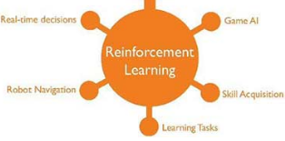

Reinforcement Learning
The program is provided feedback in terms of rewards and punishments as it navigates its problem space [4].
Notes:
In Reinforcement Learning a computer program interacts with a dynamic environment in which it must perform a certain goal for example driving a vehicle or playing a game against an opponent. The program receives feedback in terms of reward and punishment to advance.

Slide 11
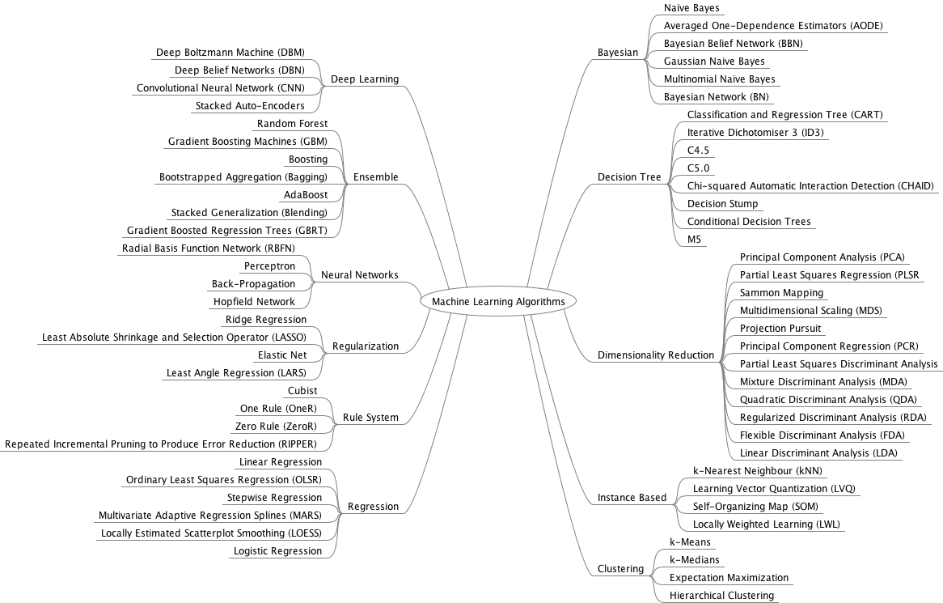
[5]
Notes:
How is it done? How these learning techniques work?
Behind every one of them is a logical algorithm and reasoning and their implementation requires coding expertise. Here you see some of the well-known algorithms currently out there

Slide 12
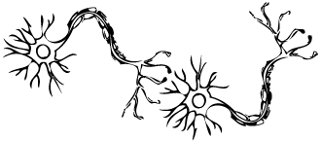

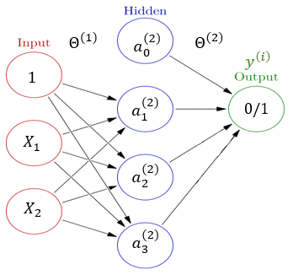
Deep Learning
Live Example
A Neural Network with many hidden layers and connections between the units, creating complex structures.
http://demo.caffe.berkeleyvision.org/
Notes:
Among those methods there is one that has captured more attention, Artificial Neural Networks.
This is a typical neuron, and you see how it has several input/output receptors. ANN is structured to mimic human brain information passing through neurons. And you see how it provides a simplified version of an actual neuron.
There is a debate that a neural network with ONLY one hidden layer can approximate any complicated function. Imagine what happens when we increase the number of hidden layers, making the network to look more like an actual human brain. This is the idea behind Deep Learning

Slide 13
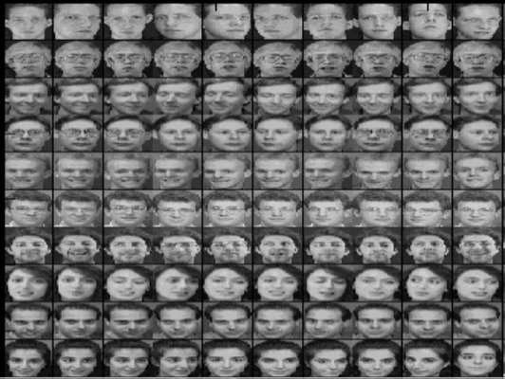
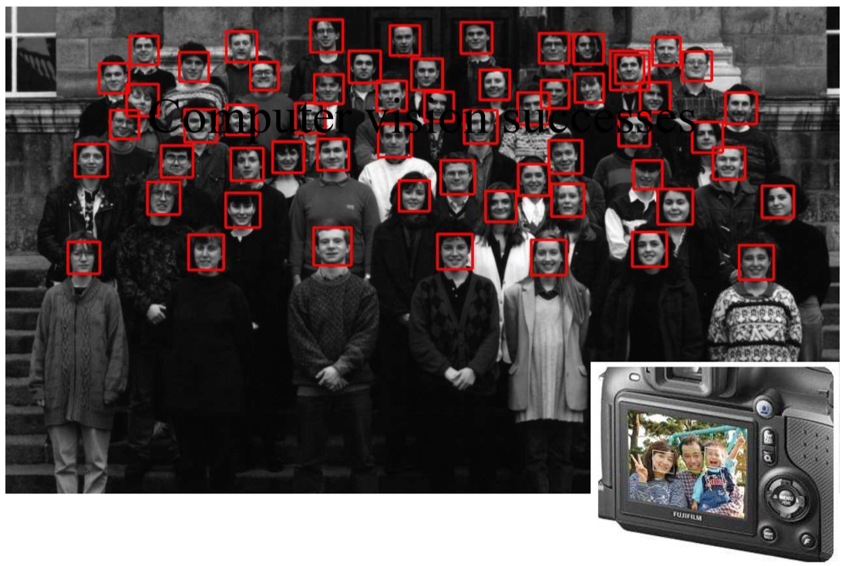
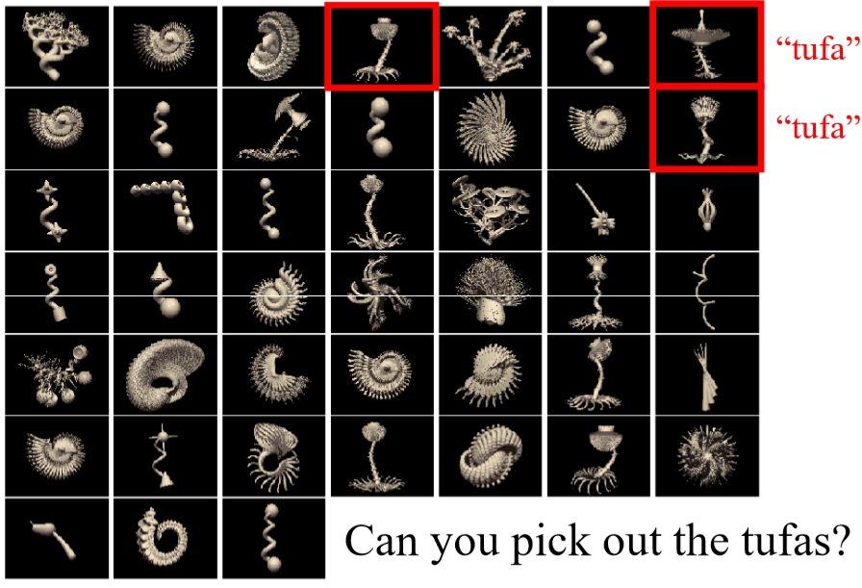
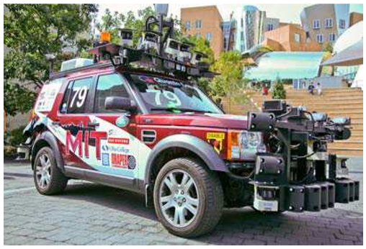
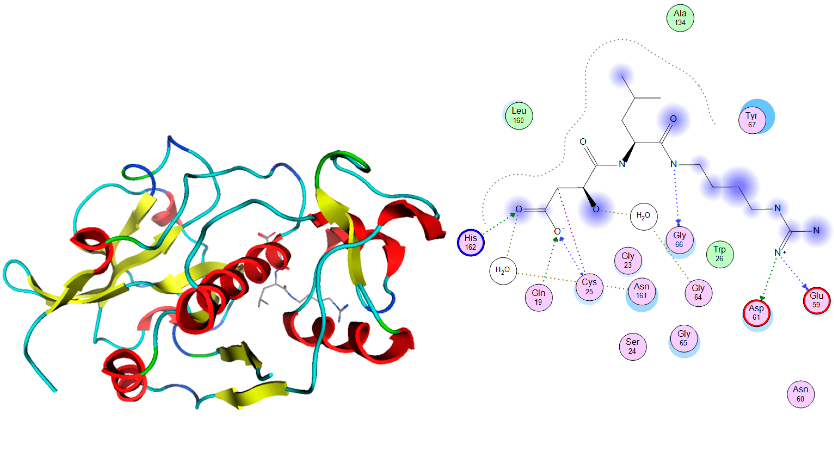
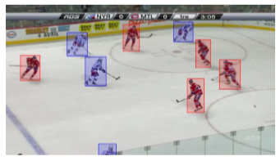
Notes:
These algorithms and their successors are used in many fields, for example, to detect smiling faces, to drive cars autonomously, to detect and track hockey players, to test if a certain drug is effective against a certain disease, etc.
Now that we have a basic understating of what machine learning is, take a look at the syllabus and the rest of the slide to see course expectations and start chapter zero which reviews important statistical subjects that will be used in later chapters.

Slide 14
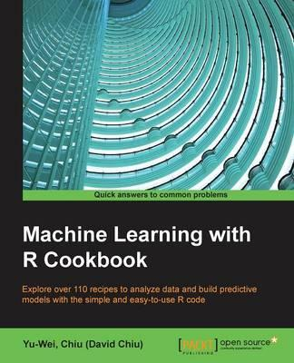
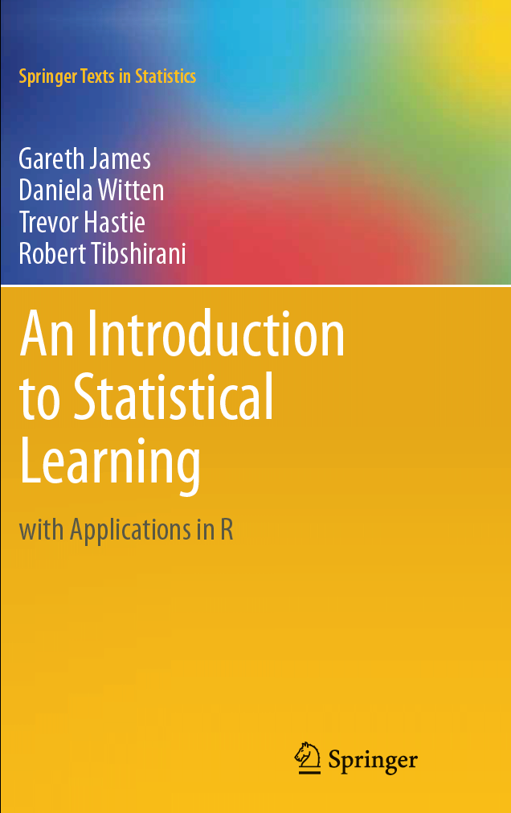
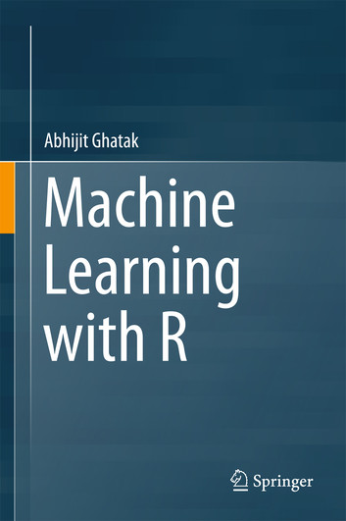
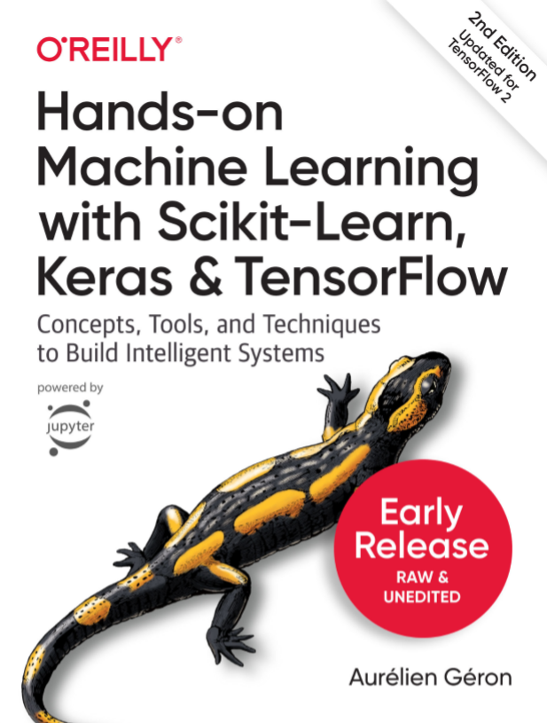
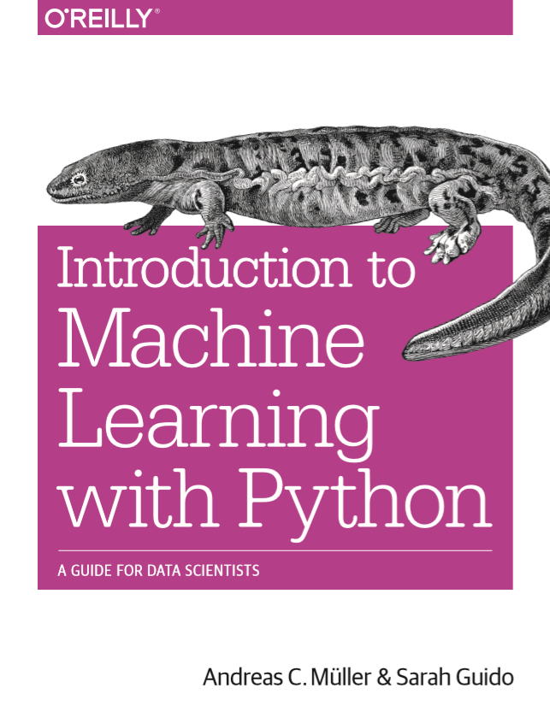
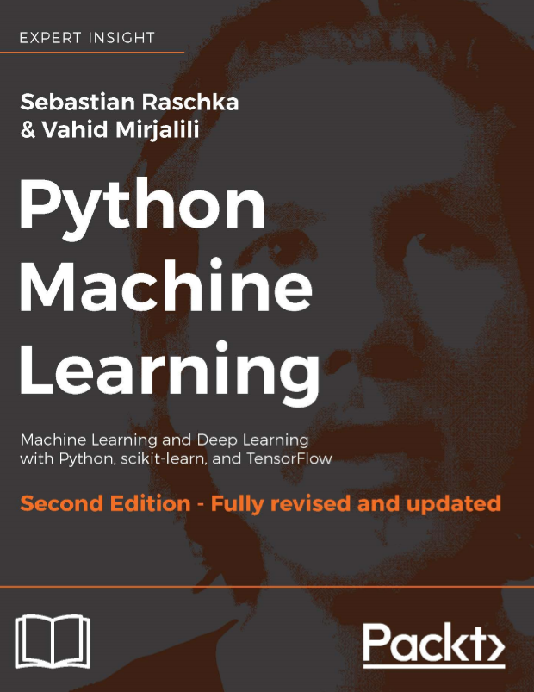
Expectations
The Tao of mastering what you learn in this course and be able to apply it is to read the material and practice them with coding.
Office: STC 209
Email: A[DOT]Saghafi[At]USciences.edu
Office Hours: See Syllabus (email me prior)
Notes:
The Tao of mastering what you learn in this course and be able to apply it is to read the material and practice them with coding. Two of these reference textbooks are available for free on the Internet, you can find their link in the syllabus.
I will provide handouts and practice problems that will be enough to understand and practice discussed subjects. If you’d like to know more, I recommend these references.
For research opportunities, finish the course and we’ll talk about it.

Slide 15
Table of Contents
Chapter 0 Introduction and Review Chapter 1 Descriptive and Inferential Statistics with R/Python Chapter 2 Simple Linear Regression and Model Diagnostics Chapter 3 Multiple Linear Regression and Goodness of Fit Measures Chapter 4 Feature Generation and Model Selection/Validation Chapter 5 Classification (Logistic Regression, ANN, SVM) Chapter 6 Decision Trees Chapter 7 Clustering (K-Mean, Hierarchical Trees, Model-based, Density-based)
Chapter 8 Dimension Reduction (PCA, KPCA, T-SNE)
Notes:
We will go over these subjects with numerous examples, try to follow the examples I do in the videos and practice with provided practice problems to hone the techniques

Slide 16


Technology
You are free to choose between R/Python with your assignments. R and Python codes will be provided along with lectures.
PRACTICE CODING
It might take you some time to figure out what each part of the code does and to write, troubleshoot your codes. This is a time well-spent.
GOOGLE
Find alternate way of solving a problem by googling and finding out other codes. Make a repository for yourself. Comment on your codes so you remember what you did when you did it.
Notes:
You are free to choose between R/Python/MATLAB with your assignments. R codes will be provided along with lectures. Instructions on how to use R is available in handouts on Blackboard.
You don’t have to be a professional coder to start and pass this course successfully and most importantly, you don’t have to memorize codes discussed in the course. Create a archive of codes and what you learn so that you can access them easily whenever you needed to. Eventually you’ll master the coding. If you do something five times, it becomes yours, make the codes yours.

Slide 17


Homework Assignments
For R users: Install R Markdown package, instructions are on chapter 1, R Markdown files should be submitted, using each homework template.
For Python users: Python Notebook files should be submitted, instructions are on chapter 1.
* The submitted codes should be accompanied with your reports written in the same file with Markdown notes and MUST run without errors.
You may use a free cloud-based computing service provided by IBM that facilitates running both R and Python codes. Instructions on how to create an IBM Watson account and share its content is available on course roster.
Notes:
You should create an IBM Watson account and learn to write codes plus reports in provided notebooks

Slide 18
Grading Rubric
Extra Credit: Up to 4% extra credit relative to you score on an end-of-the semester assessment test.
100%
35% Q
40% - CH
20% - PR
Quiz (Q): There are five questions at the end of each week with three attempts. You need to score at least 40% to access materials of next week.
Bi-weekly Homework Assignments (HW):
6 bi-weekly homework assignments, should be completed and uploaded on Bb before the due dates.
Project (PR):
The subjects and descriptions will be released once you score at least 40% on week 9 quiz.
Notes:
Quizzes contribute to 35% of your course grade, Chapter Assignments contribute to 40%, Project has 20% weight on your course grade.
Practice Problems are provided for each week material, they include answers, it’s best if you at least read the questions, think about proper codes to accomplish the task, then see the answers. At least run the answers once to see the outputs.

Slide 19

● Read chapter handouts BEFORE class, print the class slides, then come to class and pay attention, take notes and add them to your material.
● ASK QUESTIONS if you do not understand something, odds are you aren't the only one, ask questions. Take advantage of the office hours.
● GET HELP EARLY if you are struggling. If you wait until the night before a test to learn weeks’ worth of material it can be overwhelming and it usually does not end well.
● PRACTICE, try to work the examples yourself, spend time on solving practice and homework problems, run the codes, watching me solve the problems or reading the answers is not enough.
● DO NOT wait until the last minute to start the assignments, distribute the work over the week.

Slide 20
References
[1] linkedin.com/pulse/business-intelligence-its-relationship-big-data-geekstyle
[2] Frank, A., Asuncion, A., UCI Machine Learning Repository, http://archive.ics.uci.edu/ml, 2010.
[3] Andrew Ng, Machine Learning on Coursera, Stanford University, Accessed July 2015.
[4] Google’s DeepMind AlphaGo, Accessed Jan 2018, https://deepmind.com
[5] Jason Brownlee, A Tour of Machine Learning Algorithms, Accessed Jan 2018, https://machinelearningmastery.com/a-tour-of-machine-learning-algorithms

Slide 21
Probability Distributions Summary
Dr. Abolfazl Saghafi
Assistant Professor of Statistics
Data Science Program Director
Notes:
In this session we review some of the probability distributions that we will be using through the course.

Slide 22
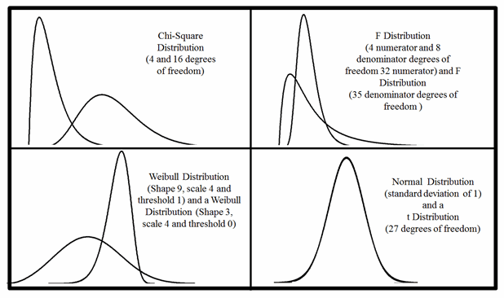
Summary
● Normal and Standard Normal distributions
● Central Limit Theorem
● t-distribution
● Gamma function
● Chi-square distribution
● F distribution
● Bivariate Normal
Notes:
A probability distribution, is a description of a random phenomenon in terms of the probabilities of events. It helps us to study the behavior of random phenomenon and make probabilistic statements regarding their behavior. As a quick review, we go through a number of probability distributions that will be used A LOT in regression and highlight some of their properties.

Slide 23
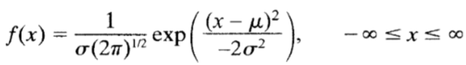
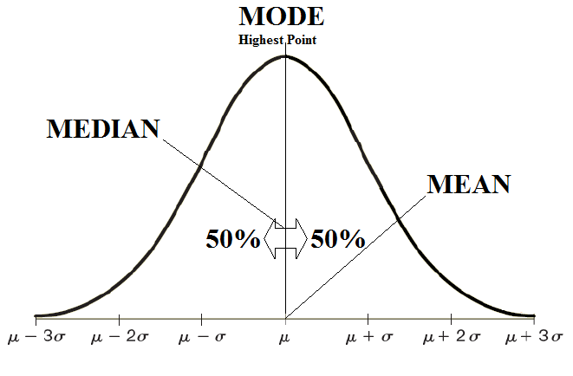
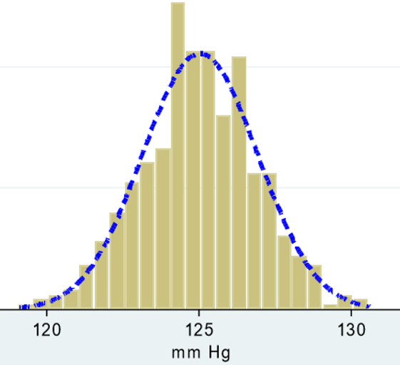
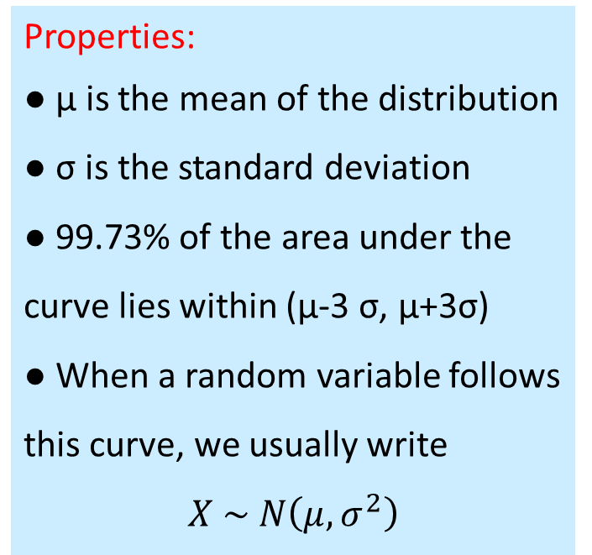
Normal Distribution
Properties:
● μ is the mean of the distribution
● σ is the standard deviation
● 99.73% of the area under the curve lies within (μ-3 σ, μ+3σ)
● When a random variable follows this curve, we usually write
$$X \sim N\left(μ, σ^{2}\right)$$
Normal Probability Density Function (PDF) is represented by
Notes:
Normal or Gaussian distribution is the most important statistical distribution that is used to model many natural phenomena. For example height or weight of a large group of people selected randomly look like the normal bell-shaped curve. That small graph shows histogram of blood pressure for a sample of 200 patients and you see how the histogram matches the normal curve.
That curve, the normal probability density function or as we call it PDF, is represented mathematically by this expression, f(x). The PDF depends on two parameters, μ which controls the center of the curve, and σ which controls the spread.
The distribution is symmetric about its mean μ and has a standard deviation of σ, which is such that practically all of the distribution (99.73%) lies inside the range (μ-3 σ, μ+3σ). When a random variable follows such normal curve, we show it as X ~ Normally with mean mu and variance sigma squared. Read “~” as distributed.

Slide 24
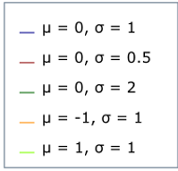
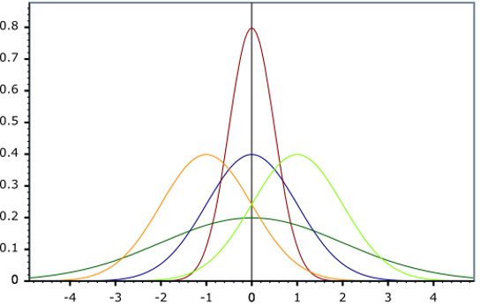
Standard Normal Distribution
Using the transformation
$$Z=(X−μ)/σ$$
a standard normal distribution is achieved
$$Z \sim N\left(0, 1\right)$$
For random variable $X$ with mean $μ$ and variance $σ^{2}$,
$$Z=(X−μ)/σ$$
has a mean of $0$ and a variance of $1$.
Notes:
As I mentioned, mu and sigma control the center and spread of the distribution. You can see how changing these two parameters change the normal curve.
Using a simple transformation, subtracting the random entity by its mean and dividing by its standard deviation, creates a normal curve which is centered at 0 and has a standard deviation of 1. Any such RV, that is any RV that has a mean of 0 and variance or standard deviation of 1 is said to be a standard RV.

Slide 25
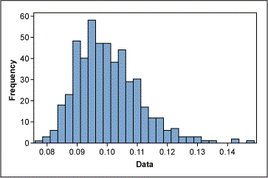
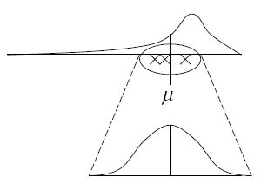
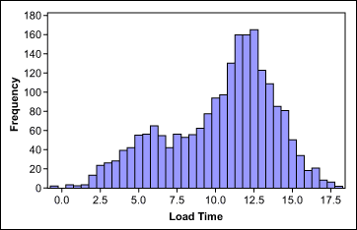
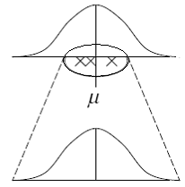
Central Limit Theorem
$$\overline{X}=\frac{1}{n}\sum_{i=1}^{n}{X_{i}}$$
$$X_{1}, X_{2},…,X_{n} \sim N(μ,σ^{2})$$
Then
$$\overline{X} \sim N(μ,σ^{2}/n)$$
$$X_{1}, X_{2},…,X_{n} \sim ?(μ,σ^{2})$$
Then
$$\overline{X} ≈ N(μ,σ^{2}/n)$$
$$\frac{\overline{X}−μ}{σ/\sqrt{n}} ≈ N(0,1)$$
Notes:
Many practices in regression, and in statistics in general, make some assumptions concerning the population that the data was obtained from. That is how the structure and mathematics of problems are formulated. One assumption that is widely made in a statistical inference is that the variable of interest in the population is normally distributed.
The assumption of data coming from a normal distribution seems a little unrealistic in general. Just a little work with some real-world data shows that outliers, ​skewness, multiple peaks and asymmetry show up quite routinely. However, we can get around the problem of data from a population that is not normal, and that is by a proven theorem called Central Limit Theorem.
If the population distribution is actually normal, the distribution of the sample mean follows a normal curve. Based on CLT, if the population distribution is not normal, even if it is unknown, the sample mean is approximately normal. Thus, even though we might not know the shape of the distribution where our data comes from, the central limit theorem says that we can treat the sampling distribution as if it were normal. Of course, in order for the conclusions of the theorem to hold, we do need a sample size that is large enough. Exploratory data analysis can help us to determine how large of a sample is necessary for a given situation.
By the way, sample mean is the average of measurements.

Slide 26
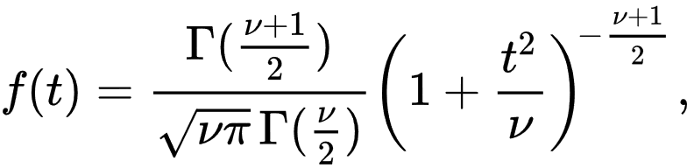
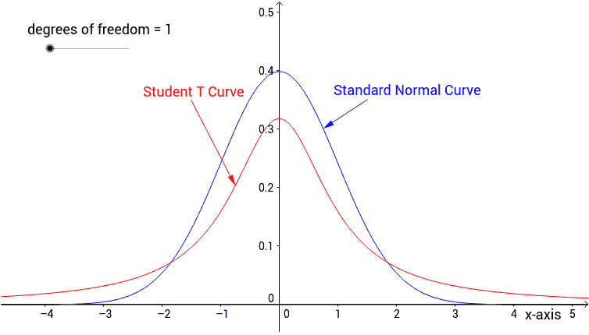
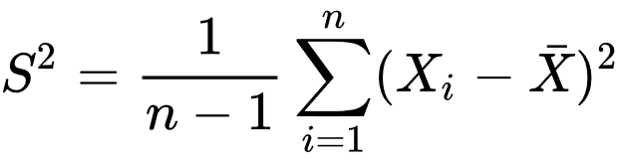
t-distribution
Properties:
● The graphs of t distributions are bell-shaped, but are not normally distributed
● The tails of a t distribution are thicker than what the tails of the normal distribution are
● As the degree of freedom increases, the distribution approaches the standard normal
A symmetric distribution given by PDF
Its shape depends on the degree of freedom $ν$. As the degree of freedom increases, the distribution approaches the standard normal distribution.
$$X_{1}, X_{2},…,X_{n} \sim N(μ,σ^{2})$$
Then
$$\frac{\overline{X}−μ}{S/\sqrt{n}} \sim t(n−1)$$
Notes:
Aside from normal distribution, there are some probability distributions that are useful in the study and practice of regression. One distribution which resembles the normal curve in many ways is called Student's t-distribution, or simply a t-distribution. As you can see, it’s a symmetric distribution, given by this PDF, defined for positive and negative values of t. Its shape depends on a parameter (nu) which is called the degree of freedom. As the degree of freedom increases, the distribution approaches the standard normal distribution.
Here is an important result that is actually why this distribution is so important. If we have a sample from a phenomenon that is normally distributed, with parameters mu and sigma squared, then Xbar subtracted by mu divided by S over square root of n follows a t-distribution with n-1 degree of freedom. S here is the square root of sample variance which is computed using this expression.

Slide 27



Gamma Function
● $Γ\left(z+1\right)=z Γ\left(z\right)$
● $Γ\left(\frac{1}{2}\right)=\sqrt{π}$
factorial, defined for non-negative integers $n$, is a way to describe repeated multiplication. For example:
$$3!=3×2×1$$
The gamma function (represented by $Γ$) is an extension of the factorial that computes factorial for any positive real number.
It is defined by
$$Γ\left(z\right)=\int_{0}^{∞}{x^{z−1}} e^{−x} dx$$
Notes:
I am sure you are familiar with factorial, defined for non-negative integers. It is denoted by the use of an exclamation mark. For example:​ 3! = 3 x 2 x 1 = 6.
The gamma function denoted by a capital letter gamma (Γ) from the Greek alphabet is an extension of the factorial that computes factorial for any positive real number. It is defined by this integral and has the same recursive property. One of the most well known results is that Γ(1/2)= √π. The graph shows how the function looks like on the real-line.

Slide 28


Chi-square distribution
$$\frac{\left(n−1\right) S^{2}}{σ^{2}} \sim χ_{(n−1)}^{2}$$
If $Z_{1},Z_{2},…,Z_{n}$ are independent, standard normal random variables, then the sum of their squares
$$\sum_{i=1}^{n}{Z_{i}^{2}}$$
is distributed according to the chi-squared distribution with k degrees of freedom.
$$\sum_{i=1}^{n}{Z_{i}^{2}} \sim χ_{(n)}^{2}$$
Notes:
If we square n random variates that have a normal distribution and add them up, we will have a random phenomenon that has a chi-square (χ2) distribution with n degrees of freedom. Chi Square distributions are positively skewed, the degree of skewness decreases with increasing degrees of freedom. The graph shows how the density functions for Chi Square distributions changes with increasing the degrees of freedom.
The primary reason that the chi-squared distribution is used extensively in regression is this expression. The sample variance times (n-1) divided by population variance follows a chi-square distribution with n-1 degree of freedom. The distribution is very important because many test statistics are approximately distributed as Chi Square.

Slide 29


F distribution
$$\frac{S_{x}^{2}/σ_{x}^{2}}{S_{y}^{2}/σ_{y}^{2}} \sim F\left(m−1,n−1\right)$$
A random variate of the F-distribution with parameters m and n arises as the ratio of two independent chi-squared variates:
$X \sim χ_{\left(m\right)}^{2}$ $⊥$ $Y \sim χ_{\left(n\right)}^{2}$
Then
$$\frac{X/m}{Y/n} \sim F\left(m,n\right)$$
Notes:
The F distribution which is widely used in regression to test significance of model parameters, is the probability distribution associated with the F statistic. F statistic is created by dividing two independent chi-square variates. The curve of the F distribution depends on two degrees of freedom, m and n. m is the degrees of freedom for the chi-square variable in the numerator and n is the one for the denominator. You can see how the PDF curve changes by changing the two degrees of freedom.
This is a very important property. We can statistically show that for two independent samples from two normal distributions, the sample variance of sample 1 divided by its population variance over the sample variance of sample 2 divided by its population variance follows a F distribution. This is widely used in testing regression models and in Analysis of Variance.

Slide 30



Bivariate Normal Distribution
Visually, the bivariate normal distribution is a three-dimensional bell curve with the following probability density function
$$f_{X,Y}\left(x,y\right)=\frac{1}{2πσ_{x}σ_{y}\sqrt{1−ρ^{2}}} e^{\frac{−1}{2\left(1−ρ^{2}\right)}\left(\frac{{\left(x−μ_{x}\right)}^{2}}{σ_{x}^{2}}+\frac{{\left(y−μ_{y}\right)}^{2}}{σ_{y}^{2}}−\frac{2ρ\left(x−μ_{x}\right)\left(y−μ_{y}\right)}{σ_{x}σ_{y}}\right)}$$
where ρ is the correlation between the two random variable X and Y.
• Each marginal distribution is normal itself
• With changing ρ, the concentration of probability changes on the xy-plane.
• ρ = 0 iff X ꓕ Y (concentration is circular)

Slide 31
Important Terminologies
Dr. Abolfazl Saghafi
Assistant Professor of Statistics
Data Science Program Director
Notes:
In this session we review some important terminologies regarding descriptive statistics

Slide 32

Summary
Size: N
● Population and Sample
● Variables
● Parameter and Statistic
● Random Sample
● Maximum Likelihood Estimation
Size: n
Notes:
Descriptive Statistics are methods of organizing and summarizing information gathered from a sample of data

Slide 33

Population and Sample
The process of statistics starts when we identify a group we are interested to study or learn something about. We call this group the population.
Sample
Due to some limitations (time, cost, feasibility, etc.) a more practical approach would be to examine and collect data only from a sub-group of the population, which we call a sample.
• For example, a car company tests 10 of their cars to estimate the mean stopping distance for auto brakes while driving at 60 mph.
• Sample should be selected randomly and should be a good representative of the population.
We should make an effort to choose a sample in such a way that it represents the population well. Because our goal is to draw conclusions about the population based on the sample results.
Notes:
The process of statistics starts when we identify a group we are interested to study or learn something about. We call this group the population. Due to some limitations (time, cost, feasibility, etc.) a more practical approach would be to examine and collect data only from a sub-group of the population, which we call a sample.
For example, a car company tests 10 of their cars to estimate the mean stopping distance for auto brakes while driving at 60 mph. Apparently, they cannot test every single car they produce to find this stopping distance, it’s not feasible. They rely on a sample of 10 cars.
We should make an effort to choose a sample in such a way that it represents the population well. Because our goal is to draw conclusions about the population based on the sample results. Sample should be selected randomly.

Slide 34

Variables
What we are interested in studying something in the population that changes between individuals. It is called variable. There are different types of variables:
• A qualitative (categorical) variable describes quality and places individuals in different categories.
• A quantitative (numerical) variable takes on a real value or numerical measurement for which sums, differences, and ratios have meaning.
Examples:
• Nominal: Eye color, Blood type
• Ordinal: Shoe size
• Discrete: number of children
• Continuous: weight, height
Notes:
What we are interested in studying is something in the population that changes between individuals. So it is called variable. We have two different types of variables:
• A qualitative (categorical) variable describes quality and places individuals in different categories. Qualitative variables are either nominal, where categories represent labels only, or ordinal, where labels can be sorted. Examples include eye color for nominal and dress size for ordinal variable.
• A quantitative (numerical) variable takes on a real value or numerical measurement. Values of quantitative variables are either discrete such as the number of children, or continuous such as weight and height.

Slide 35


Parameter and Statistic
A parameter is a numerical measure that describes the characteristic of a population.
We usually show parameters by Greek letters. For example, μ is a parameter showing the mean or center and σ² is a parameter showing the spread.
Parameters are usually unknown, our goal is to estimate them using a sample. A statistic is a numerical measure that describes the characteristic of a sample. Statistic is used as an estimation for a parameter.
To study the parameter we select a random sample from the population, that is
$$x_{1},x_{2},…,x_{n}$$
Statistic is computed using this random sample.
Notes:
A parameter is a numerical measure that describes the characteristic of a population. We usually show parameters by Greek letters. For example, μ is a parameter showing the mean or center and σ² is a parameter showing the spread.
Parameters are usually unknown, our goal is to estimate them using a sample. A statistic is a numerical measure that describes the characteristic of a sample. Statistic is used as an estimation for a parameter.
To study the parameter we select a random sample from the population, that is $x_{1},x_{2},…,x_{n}$. Statistic is computed using this random sample.

Slide 36



Random Sample
• Joint PDFs describe characteristics of multiple variables together.
• $\prod_{i=1}^{n}{a_{i}}$ means $a_{i}×…×a_{n}$ that is product of $a_{i}$ for $i=1$ to $i=n$
• The notation
$$X_{1},…,X_{n} \sim ^{iid}f_{X}\left(x\right)$$
means $X_{1},…,X_{n}$is a random sample from a population with distribution $f_{X}\left(x\right)$
• $f_{X}\left(x\right)$ reflects characteristics of random phenomenon $X$ in the population
A random sample is an iid sequence of Random Variables. iid means independent and identically distributed.
Independent Random Variables. RVs $X_{1},…,X_{n}$ is said to be independent iff their Joint PDF can be written as product of each one’s PDF, that is
$$f_{X_{1},…,X_{n}}\left(x_{1},…,x_{n}\right)=\prod_{i=1}^{n}{f_{X_{i}}\left(x_{i}\right)}$$
Identically Distributed Random Variables. The sequence of RVs $X_{1},…,X_{n}$ is said to be identically distributed iff they all have the same PDF as the population.
Notes:
You are familiar with these two definitions if you’ve taken a probability course before. A random sample is an iid sequence of Random Variables. iid means independent and identically distributed.
Independent Random Variables. RVs $X_{1},…,X_{n}$ is said to be independent iff their Joint PDF can be written as product of each one’s PDF, that is $f_{X_{1},…,X_{n}}\left(x_{1},…,x_{n}\right)=\prod_{i=1}^{n}{f_{X_{i}}\left(x_{i}\right)}$
Identically Distributed Random Variables. The sequence of RVs $X_{1},…,X_{n}$ is said to be identically distributed iff they all have the same PDF as the population.

Slide 37


Maximum Likelihood Estimation
• $\left(μ,σ^{2}\right)$ are parameters of a normal distribution that control its center and spread.
• $ν$ is the parameter of a t-distribution that controls its spread.
Parameters control characteristics of probability distributions. Given a random sample from a phenomenon that behaves probabilistically with PDF $f\left(x\right)$, the joint PDF
$$f_{X_{1},…,X_{n}}\left(x_{1},…,x_{n}\right)=\prod_{i=1}^{n}{f_{X_{i}}\left(x_{i}\right)}$$
reflects the behavior of the whole sample. When considered as a function of parameters, this joint PDF is called the likelihood function.
• The likelihood function is the joint PDF of sample when considered as a function of parameters.
• Maximizing the likelihood gives us ML point estimations.
• It is usually easier to maximize ln of the likelihood function. Results are the same
Maximum likelihood estimation (MLE) is a method of estimating the parameters of a statistical model, given observations, by maximizing the likelihood function. This maximization is usually done by setting the first derivatives of the likelihood to zero.
Notes:
Parameters control characteristics of probability distributions. Given a random sample from a phenomenon that behaves probabilistically with PDF $f\left(x\right)$, the joint PDF
$$f_{X_{1},…,X_{n}}\left(x_{1},…,x_{n}\right)=\prod_{i=1}^{n}{f_{X_{i}}\left(x_{i}\right)}$$
reflects the behavior of the whole sample. When considered as a function of parameters, this joint PDF is called the likelihood function.
Maximum likelihood estimation (MLE) is a method of estimating the parameters of a statistical model, given observations, by maximizing the likelihood function. This maximization is usually done by setting the first derivatives of the likelihood to zero.

Slide 38




Example
2. The likelihood (or Loglikelihood) function is
$$\ln{L\left(μ|x_{1},…,x_{n}\right)}=−n\ln\left(σ\sqrt{2π}\right)−\frac{1}{2σ^{2}}\sum_{i=1}^{n}{{\left(x_{i}−μ\right)}^{2}}$$
Suppose we have a random sample from normal distribution with parameters $μ$ and $σ^{2}$. The normal PDF is given by
$f\left(x\right)=\frac{1}{σ\sqrt{2π}}\exp\left(\frac{−{\left(x−μ\right)}^{2}}{2σ^{2}}\right)$
Find the MLE for $μ$.
3. Maximizing the likelihood (or Loglikelihood) function is achieved by taking derivative of the parameters and set it to zero.
$$\frac{d}{dμ}\ln{L\left(μ|x_{1},…,x_{n}\right)}=0−\frac{−2}{2σ^{2}}\sum_{i=1}^{n}{\left(x_{i}−μ\right)}=0$$
Here results in the following values for the parameter
$$\hat{μ}=\frac{1}{n}\sum_{i=1}^{n}{x_{i}}=\overline{x}$$
Which is the ML estimation for $μ$.
1. The joint PDF of the random sample is
$$L\left(μ|x_{1},…,x_{n}\right)=\prod_{i=1}^{n}{f_{X_{i}}\left(x_{i}\right)}=\prod_{i=1}^{n}{\left(\frac{1}{σ\sqrt{2π}}\exp\left(\frac{−{\left(x_{i}−μ\right)}^{2}}{2σ^{2}}\right)\right)}={\left(\frac{1}{σ\sqrt{2π}}\right)}^{n}\exp\left(\frac{−\sum_{i=1}^{n}{{\left(x_{i}−μ\right)}^{2}}}{2σ^{2}}\right)$$
Notes:
The estimation a computer software provides are usually the Maximum Likelihood estimations. We don’t spend time on finding ML estimations, but it is good to know how they are found.

Slide 39
Inferential Statistics Summary
Dr. Abolfazl Saghafi
Assistant Professor of Statistics
Data Science Program Director
Notes:
In this section we will review some important inferential statistics subjects. If you’ve taken any statistics course, you’d be familiar with these subjects.

Slide 40

Summary
Size: N
● Estimation
● Point Estimations
● Interval Estimation
● Testing Hypothesis
● Null and Alternate Hypothesis
● P-value
Size: n
Testing Hypothesis
Estimation
Point Estimation
Interval Estimation
Notes:
Inferential Statistics are methods of using information from a sample to make inferences/conclusions about a population.

Slide 41



Point Estimation
Notations:
● $θ$ is the parameter of interest
● $\hat{θ}$ point estimation for $θ$
● (L, U) represent Lower and Upper bounds in a Confidence Interval
● is indicative of an estimated value.
Point estimation involves the use of sample data to calculate a single value (known as a statistic) which serves as a "best guess" or "best estimate" of an unknown population parameter $θ$.
Interval estimation is the use of sample data to calculate an interval of probable values, say (L, U), of an unknown population parameter $θ$. This interval is called confidence interval.
The population here all the commute time.
The sample is these 7 commute times.
Example: Assume you want to estimate the time it takes for you to get home after work using a week’s commute data
18 32 22 35 25 22 21
Notes:
Point estimation involves the use of sample data to calculate a single value (known as a statistic) which serves as a "best guess" or "best estimate" of an unknown population parameter θ. We usually show population parameters by Greek alphabets, θ is used in general to represent a population parameter. The point estimate for θ is shown by that notation, called theta hat.
Interval estimation is the use of sample data to calculate an interval of probable values, shown by an interval of numbers (L, U), where L represent a lower bound and U represent an upper bound, of an unknown population parameter θ. This interval is called confidence interval.
For example: assume you want to estimate the time it takes for you to get home after work using a week’s commute data. In this case, the population here all the commute time. The sample is these 7 commute times.

Slide 42






Example
Notations:
● $μ=\frac{1}{N}\sum_{i=1}^{N}{X_{i}}$ is the population mean
● $\overline{X}=\frac{1}{n}\sum_{i=1}^{n}{X_{i}}$ is the sample mean
● $σ^{2}=\frac{1}{N}\sum_{i=1}^{N}{{\left(X_{i}−μ\right)}^{2}}$ is the population variance
● $\hat{σ^{2}}=S^{2}=\frac{1}{n−1}\sum_{i=1}^{n}{{\left(X_{i}−\overline{X}\right)}^{2}}$ is the sample variance
Assume you want to estimate the time it takes for you to get home after work using a week’s commute sample data
18 32 22 35 25 22 21
$$\hat{μ}=\overline{x}=\frac{18+…+21}{7}=25$$
$$Var\left(\overline{X}\right)=\frac{σ^{2}}{n}=\frac{σ^{2}}{7}$$
$$s^{2}=\frac{1}{6}\sum_{i=1}^{n}{{\left(X_{i}−25\right)}^{2}}=\frac{{\left(18−25\right)}^{2}+…+{\left(21−25\right)}^{2}}{6}=38.67$$
$$\hat{Var\left(\overline{X}\right)}=\frac{S^{2}}{n}=\frac{38.67}{7}=5.52$$
$$se\left(\overline{X}\right)=\sqrt{\hat{Var\left(\overline{X}\right)}}=2.35$$
Notes:
A parameter of interest here is the population mean, the mean commute time which is usually shown by Greek letter mu. A point estimate for mu is sample mean, xbar, which is shown by this notation, and simply is the average sample measurements.
A point estimate should always be accompanied with its variance to show a measure of accountability. Here, variance of Xbar is sigma square, which is the population variance over n, which is the sample size. To compute the sigma square, we should have access to the population data which is impossible here. So, we can’t compute it. What we can do is to estimate using the sample data, just as we did with mu. A point estimation for sigma square, shown by sigma square hat, is S square, sample variance. It is computed as the average squared deviation from sample mean. Once we have an estimation for population variance, we can estimate variance of Xbar.
The final point is the standard error of Xbar, which is simply the square root of an estimate for variance of Xbar. The reason for taking the square root is to have a measure that has the same unit as the data itself. Since the data is squared in computing the variance, the unit of variance is unit of data squared.
Of course, you should already be familiar with this type of problems and notations. This is just a short summary.

Slide 43














Confidence Intervals
Notations:
● $σ_{\hat{θ}}$ be the standard deviation of $\hat{θ}$ and se($\hat{θ}$ ) be its estimation
The general way to build a (1-α)% confidence interval for parameter $θ$ is to use
$$\overline{x}=25$$
$$se\left(\overline{X}\right)=2.35$$
Point estimate
($\hat{θ}$)
A $t$ percentage point leaving $α/2$ in the upper tail, based on $υ$ degree of freedom
($t_{\left(υ,α/2\right)}$)
Standard error of the point estimate
(se($\hat{θ}$ ) )
$$t_{\left(6,0.025\right)}=2.45$$
$$±$$
$$×$$
$$25±\left(2.45×2.35\right)$$
$${\left(19.25, 30.75\right)}_{95\%}$$
Margin of Error
Notes:
The general way to build a (1-α)% confidence interval for parameter $θ$, is to use a point estimate as the center of the interval, and move away from the center from both sides based on some probabilistic value called margin of error. Think of it as a compass. The fixed leg act as the point estimate, we open the legs according to margin of error, and compute the lower and upper confidence bounds.
Here is when the Central Limit Theorem comes into place. According to CLT, Thetahat has a normal distribution. Therefore, its standard error follows a t-distribution with a degree of freedom of sample size minus one. If we multiply the standard error, by a t-critical value, we have the degree to which the compass should be opened, the margin of error.
From the previous example, the point estimate xbar was 25 with standard error of 2.35. For a 95% confidence interval, the t-value is 2.45. Thus, the 95% confidence interval will be from 19.25 to 30.75. This means that, on average 95% of the times the commute time takes between 19 to 31 minutes.

Slide 44
Testing Hypothesis
Example:
Channel 5 news states that teenagers in the US watch an average of 12 hours of TV per week.
● Parameter under claim is mean time (μ) of watching TV by teenagers
● Hₒ: μ = 12 h
● H₁: μ ≠ 12
Some terminologies regarding testing are as follows:
● Statistical Hypothesis is an assumption about a population parameter (θ) which may or may not be true.
● The Null Hypothesis denoted by Hₒ states the initial hypothesized claim or the statement under investigation. In this course it is always stated as equality, i.e. θ = θₒ where θₒ is given (usually is 0)
● The Alternate Hypothesis denoted by H₁ is the opposite of the null which comes in one of the three forms depending on our preferences
Two-sided: θ ≠ θₒ
One-sided: θ < θₒ or θ > θₒ
The testing is performed using a statistic, usually a t-statistic
$$t=\frac{\hat{θ}−θ_{0}}{\text{se}\text{(}\hat{θ}\text{ )}}$$
that generates different values under Hₒ and H₁ assumptions. Thus, it can be used to see which one sounds true with a given data.
Notes:
Some terminologies regarding testing are as follows:
● Statistical Hypothesis is an assumption about a population parameter (θ) which may or may not be true.
● The Null Hypothesis denoted by Hₒ, states the initial hypothesized claim or the statement under investigation. In this course it is always stated as equality, i.e. θ = θₒ where θₒ is given (usually is 0)
● The Alternate Hypothesis denoted by H₁ is the opposite of the null which comes in one of the three forms depending on our preferences
θ ≠ θₒ or θ < θₒ or θ > θₒ
For example, lets say channel 5 news states that teenagers in the US watch an average of 12 hours of TV per week.
● Parameter under claim is mean time (μ) of watching TV by teenagers
● Hₒ: μ = 12 h
● H₁: μ ≠ 12
The testing is performed using a statistic, usually a t-statistic $t=\frac{\hat{θ}−θ_{0}}{\text{se}\text{(}\hat{θ}\text{ )}}$ that generates different values under Hₒ and H₁ assumptions. Thus, it can be used to see which one sounds true with a given data.

Slide 45


P-value
To test $H_{0}: θ=θ_{0}$, we evaluate the statistic
$$t=\frac{\hat{θ}−θ_{0}}{\text{se}\text{(}\hat{θ}\text{ )}}$$
This "observed value of t" is then placed on a diagram of the $t_{\left(υ\right)}$ distribution, the tail probability beyond that is evaluated and doubled for a two-sided alternate. This probability is known as the p-value.
If p-value < significance level α, then we reject the null hypothesis at sig. level α or with (1- α)% confidence. Otherwise, we FAIL TO REJECT Hₒ
α is usually set to be 1%, 5%, or 10%, 5% is more common.
For borderline p-value (p-value ≈ α) we usually postpone the decision until more data is gathered
Failing to reject Hₒ is different in meaning that accepting it
Notes:
Many statistical software report a value called p-value which is used to make the final testing inference. P-value in some statistical softwares is shown by sig. It is the probability of finding the observed, or more extreme, results when the null hypothesis (Hₒ) is true.
To compute the p-value, after computing the "observed value of t“, we placed on a diagram of the $t_{\left(υ\right)}$ distribution, whatever the degree of freedom is. Then, the tail probability beyond that is evaluated. If the alternate is two-sided we double this probability.
To make a decision, if p-value < significance level α we reject the null hypothesis at sig. level α or with (1- α)% confidence. Otherwise, we FAIL TO REJECT Hₒ. For borderline p-value, p-value ≈ α, we usually postpone the decision until more data is gathered.
Failing to reject Hₒ is different in meaning that accepting it

